Slide 1
Agenda
Welcome
Introduction to the USMCA Center
Entry Procedures
USMCA Resources
Questions
USMCA Center
Notes:
Good afternoon everyone and welcome to today’s briefing on the new United States-Mexico-Canada Agreement, or USMCA
Today, we will provide an overview of USMCA
Here is a preview of the topics that we will cover in today’s briefing
We will first provide an overview and background of the USMCA Agreement and how it came to fruition;
Next we will cover entry procedures so that you can learn how to make a claim under USMCA.
Next, we will introduce the USMCA Center, a central repository for USMCA-related guidance and resources;
Finally, we will detail the multitude of USMCA-related resources that are available to you to support your preparations for USMCA entry-into-force on July 1, 2020

Slide 2
Welcome
Thank you for joining today’s USMCA Informational Webinar
The objectives of this webinar are to –
Present an overview of the U.S. Customs and Border Protection (CBP) Office of Trade’s efforts to implement USMCA
Answer questions and share resources to help prepare trade industry members for USMCA entry into force on July 1, 2020
USMCA Center
Notes:
I would like to thank you all again for joining us today
To reiterate, the objectives of this webinar are to:
Present an overview of our, efforts to implement the USMCA; and answer questions and share resources to help you prepare for entry-into-force

Slide 3
USMCA Background and Overview
USMCA Center
Notes:
With that, we will turn it over to XXX to begin our discussion on the USMCA overview

Slide 4
USMCA Overview
While many provisions modernize those existing within NAFTA, the new USMCA Agreement does feature new and novel provisions related to automotive goods
Increased Regional Value Content (RVC) (62.5% → 75%)
Labor Value Content (LVC) Requirement – importers must certify that a certain percentage of the automobile’s content (by value) is sourced from manufacturing facilities in the US, MX, and CA that pay at least $16 USD
New Steel and Aluminum Requirements – importers must certify that at least 70% of the vehicle producer’s overall annual purchases of steel and aluminum by value are sourced from North America
CBP is working closely with our government partners in CA and MX, and the trade community to ensure a comprehensive and smooth implementation from NAFTA to USMCA.
USMCA Center
Notes:
USMCA Overview
There are new and novel provisions for Automotive RoO but there are also things that stay the same Some highlights are:
Regional value content calculation methods have remained the same; while product-specific thresholds have changed
The required RVC percentages under USMCA will be higher than what they were under NAFTA
The required RVC percentages will 75% for passenger vehicles and light trucks, and 70% for heavy trucks – and the percentages for parts of these vehicles will be in that same general range
Labor Value Content (LVC) is a new and novel criteria for automotive goods that was introduced in the new USMCA
Under the new USMCA LVC provisions, automotive goods will only receive preferential tariff treatment if the importer certifies that a certain percentage of the automobile’s content (by value) is sourced from manufacturing facilities paying at least $16 per hour USD
As the slide reads: Passenger vehicles, light truck or heavy trucks are originating if at least 70% of the producer’s annual purchases of steel and aluminum are originating
So, what does this mean? It means that USMCA requires that 70% by value of a vehicle producer’s corporate purchases of steel and aluminum must be manufactured in the United States, Canada, or Mexico
CBP is collaborating with U.S. Government partners, Canadian and Mexican counter parts, and the Trade community to ensure a comprehensive and smooth implementation of the USMCA.

Slide 5
General Information and Key Dates
Provision | USMCA
GENERAL INFORMATION
Agreement Name | United States – Mexico – Canada Agreement
Implementation Date | July 1, 2020
Expiration | Includes sunset provision – renewal consideration required every six (6) years, with a 16-year sunset clause
Merchandise Processing Fee (MPF) | Originating goods and tariff preference level (TPL) goods are exempt if the claim for preferential tariff treatment is made at the time of entry
Post-Importation Preference Claim | USMCA allows post-importation preference claim to request a refund of excess duties within one year of importation in accordance with 19 USC 1520(d). However, MPF paid on entries are not refunded
CITATIONS
HTS General Note (GN) | While not yet published, the applicable General Note will be General Note 11 (GN 11)
CFR | The USC citation is to be determined, but USMCA will be reflected in 19 CFR182
Special Program Indicator | Tariff items eligible for preferential tariff treatment under USMCA will leverage a new Special Program Indicator (SPI) of “S” that will be reflected in the “Special” column of the Harmonized Tariff Schedule of the United States (HTSUS)
CBP will continue to keep the trade industry apprised of additional information, once available
USMCA Center
Notes:
General Information and Key Dates
The following slides detail specific provisions of the new USMCA agreement – some items to highlight include:
USMCA includes a 16-year sunset clause and all three parties are required to re-evaluate the agreement every six years
USMCA adopts the same duty phase-out from NAFTA
Originating goods and tariff preference level, or TPL, goods are exempt from Merchandise Processing Fees if the claim is made at time of entry
Goods claiming USMCA preferential treatment may not leave customs’ control nor undergo production in a third party non-Party – this provision is the same as NAFTA
Primary responsibility for compliance has shifted to the importer
CBP is currently awaiting additional clarity on USMCA citations from CBP Regulations and Rulings
While not yet published, the applicable General Note will be General Note 11
The USC citation is to be determined, but USMCA will be reflected in 19 USC 182
We will be sure to update the field with any and all information, once available

Slide 6
Introduction to the USMCA Center
USMCA Center
Notes:
Introduction to the USMCA Center
We will now turn it over to XXX to present on the USMCA Center
Good afternoon all, my name is XXX and I serve as a member of USMCA Center
I will now provide an overview of the USMCA Center, which is a cornerstone piece of CBP OT’s strategy for successfully implementing USMCA

Slide 7
USMCA Points of Contact
Tamica Solomon
Acting Director, USMCA Center, CBP OT
Adam Sulewski
USMCA Center Lead, CBP OT
Maya Kamar
Director, Textiles and Trade Agreements Directorate (TTAD), CBP Office of Trade (OT)
Margaret Gray
Branch Chief, Trade Agreements Branch (TAB), CBP OT TTAD
Anita Harris
Branch Chief, Textile Policy, CBP OT TTAD
Jacqueline Sprungle
Branch Chief, Enforcement, CBP OT TTAD
USMCA Center
Notes:
Today, the following individuals from CBP Office of Trade will be leading the presentation:
Tamica Solomon – Acting Director of the USMCA Center
Adam Sletsski
Minneka Bookhart- Auditor USMCA Center

Slide 8
USMCA Center
Overview
Launched in March 2020, the USMCA Center, or Center, is the US Government (USG) lead for implementation of the USMCA Rules of Origin.
Housed in the CBP Office of Trade (OT) and includes SMEs from across CBP HQ and Centers of Excellence and Expertise
Will operate for three to five years
Coordinates, tracks, and promotes CBP implementation efforts
Supports the policy-focused USMCA efforts of CBP OT’s Textiles and Trade Agreements Division (TTAD)
Guiding Responsibilities
Coordination
Communication
Regulations and Policy
Ensure smooth implementation of USMCA by leading international, inter-agency, and inter-office coordination
Lead USMCA-related communication for all stakeholders through across platforms, including training, informational briefings, compliance guidance, and online resources
Track and support the development of all USMCA-related legal and regulatory documents, including uniform, interim, and domestic regulations, and interagency agreements
USMCA Center
Notes:
USMCA Center – Overview
The USMCA Center is your one stop shop for all things USMCA. The USMCA Center will coordinate CBP’s implementation and enforcement of the USMCA to ensure a smooth transition with consistent and comprehensive guidance to our internal and external stakeholders
We are organizationally housed within CBP’s Office of Trade (OT) and our center includes SMEs from across CBP’s HQ offices and Centers of Excellence and Expertise (Centers). Our staff is made up of Audits, Attorneys, National Entry and Import Specialist to name as few.
We Launched the Center in March 2020 and this Center will operate for three to five years
The purpose of this Center is to Coordinate, track, and promote implementation and enforcement efforts
USMCA Center core responsibilities will evolve from focusing on implementation pre entry into force to more communication and training on regulations and policy post entry into force.
We have three guiding responsibilities,
Coordination
Communication
Regulations and Policy
We are your Center so whatever you need please check us out first. We have tons of resources which leads us into our next topic.

Slide 9
Entry Procedures and Requirements
USMCA Center

Slide 10
Topics Covered
Entry Procedures
Making a Claim
Merchandise Processing Fees (MPF)
Reconciliation
Drawback
Country of Origin Marking
Post-Importation Claims
De Minimis for Non-Textiles
Treatment of Sets
Transit and Transshipment

Slide 11
Making a Claim – Overview
General Requirements
Tariff items eligible for preferential tariff treatment under USMCA will leverage a new Special Program Indicator (SPI) of “S” that will be reflected in the “Special” column of the Harmonized Tariff Schedule of the United States (HTSUS)
When filing a claim, the filers certifies that the goods comply with all rules of origin (RoO) and record keeping requirements, including those relating to auto and all other requirements
Additional Considerations
USMCA preference may also be claimed on unconditionally free tariff items, provided that they meet all requisite USMCA requirements, in order to receive an exemption from Merchandise Processing Fees (MPF). In these cases, SPI “S” will NOT be listed in the “Special” column of the HTSUS, but is still required when filing a claim to receive MPF exemption.
S+
A “S+” SPI will also be available, though further guidance from USTR and CBP Regulations and Rulings (R&R) is needed on scope and use guidelines
USMCA Center

Slide 12
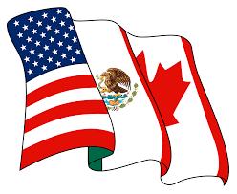
Making a Claim – NAFTA Transition
For most entry types, refer to the date of entry or withdrawal for consumption in order to determine whether to apply NAFTA or USMCA –
Apply NAFTA If entry date is prior to July 1, 2020
Apply USMCA If entry date is on or after July 1, 2020
The following entry types do have special handling requirements in USMCA, which will be explored in subsequent slides:
Reconciliation (Entry Type 09)
Drawback (Entry Type 47)
Note: Entry Type 08, NAFTA Duty Deferral will continue to exist as Entry Type 08, USMCA Duty Deferral
USMCA Center

Slide 13
Merchandising Processing Fees (MPF)
MPF Exemptions
Exempt Claim filed at time of entry
NOT Exempt Post-importation claims
Claims for MPF exemptions on originating and tariff preference level goods must be made at time of entry
All ACE programming updates needed to process MPF exemption and 19 USC 1520(d) restrictions will be live by EIF on July 1, 2020
Restriction applies to both individual and reconciliation fillings
Legislative remediation is needed to reverse policy and permit refunds under USMCA - TTAD and R&R are collaborating on reconciliation entries guidelines
Currently, USMCA does not permit MPF refunds on post importation claims
USMCA Center

Slide 14
Reconciliation
Reconciliation (Entry Type 09) Processing
Starting July 1, 2020, importers can flag an entry summary at the time it is filed for the possibility of making a post-importation claim for USMCA
Reconciliation entries are not mandatory, but it is the exclusive means to file a USMCA claim once the Entry Summary is flagged
After flagging the entry summary, the filing of a separate USMCA claim covering the entry summary will be considered duplicative and will not be accepted
Below are two scenarios where both a NAFTA and USMCA claim are applicable after USMCA entry-into-force:
A
Entry Summary XXX (date of importation June 20, 2020) was flagged for a possible NAFTA claim on June 30, 2020
On June 19, 2021, the importer filed a reconciliation ET09 claiming NAFTA
B
Entry Summary YYY (date of importation July 2, 2020) was flagged for a possible USMCA claim on July 12, 2020
On July 11, 2021, the importer filed a reconciliation ET09 claiming NAFTA
Further questions regarding Reconciliation processing should be sent to OT-RECONFOLDER@cbp.dhs.gov
USMCA Center

Slide 15
Drawback
In general, USMCA retains the drawback restrictions that exist under NAFTA
However, USMCA does feature five key changes or considerations listed below:
Substitution Standards
Sugar Exception
Conditions of Export
ACE Indicator for Drawback
Drawback Claims for Section 201 and/or 301 Duties (No Change)
Further questions regarding Drawback processing should be sent to OTDRAWBACK@cbp.dhs.gov
USMCA Center

Slide 16
Drawback
Summary of NAFTA-to-USMCA Considerations:
Substitution Standards
USMCA adopts TFTEA substitution standards when drawback is permitted (i.e., substitution under the same 8-digit HTSUS subheading rather than “same kind and quality” substitution”)
Sugar Exception
USMCA expands scope of sugar exception, which retains substantial transformation substitution standards (i.e., pre-TFTEA substitution standards) of “same-kind-and-quality” for specific sugar products, to benefit the trade
Conditions of Export
USMCA removed a NAFTA provision that applied a fee pursuant to Section 22 of the U.S. Agricultural Adjustment Act, subject to Chapter Seven (Agriculture and Sanitary and Phytosanitary Measures)
USMCA Center

Slide 17
Drawback
Summary of NAFTA-to-USMCA Considerations:
ACE Indicator for Drawback
For entries that are relevant for drawback under USMCA, CBP has created an ACE indicator (check box) that is added at the claim level to handle drawback – CBP expects that sunset for drawback entries will be at least 5 years after USMCA EIF
Drawback Claims for Section 201 and/or 301 Duties (No Change)
As with NAFTA, drawback filers for USMCA can submit claims related to Section 201 and/or 301 duties – please see Cargo Systems Messaging Service #19-000050
USMCA Center

Slide 18
Drawback
Does NAFTA or USMCA Apply?
June 30, 2020
July 1, 2020
July 2, 2020
Before USMCA EIF
On USMCA EIF
After USMCA EIF
Only NAFTA drawback claims can be filed with designated imports dated on or before 6/30/2020
NAFTA drawback claims can be filed (until 2025) with designated imports dated on or before 6/30/2020
NAFTA drawback claims can be filed (until 2025) with designated imports dated on or before 6/30/2020
Must Check NAFTA Indicator
USMCA drawback claims can be filed with designated imports dated 7/1/2020
USMCA drawback claims can be filed with designated imports dated on and after 7/1/2020
N/A
Must Check USMCA Indicator
Note that an import dated 6/30/2020 and an import dated 7/1/2020 will not be allowed on the same drawback claim – drawback claimant would need to file two separate claims for NAFTA and USMCA with the respective consumption entry date
USMCA Center

Slide 19
Country of Origin Marking
General Guidance
The rules of origin contained in 19 CFR 102 determine the country of origin for marking purposes of a good imported from Canada or Mexico in accordance with the requirements of 19 CFR Part 134
For most goods, only product specific RoO contained in GN 11 are needed to determine whether the goods are originating
Changes from NAFTA
Unlike NAFTA, a good does not need to qualify to be marked as a good of CA or MX in order to receive preferential tariff treatment under USMCA
Exception: Certain agricultural goods
In addition, a good with a non-foreign origin (i.e. a US good) is also eligible for preferential tariff treatment and U.S. will also be accepted as a country of origin on a USMCA claim
USMCA Center

Slide 20
Post-Importation Claims
USMCA allows importers to file a post-importation claim to request a refund of excess duties paid on qualifying goods pursuant to 19 USC 1520(d). Post-summary corrections (PSC) are not allowed for USMCA claims
In general, there is no change in requirements between NAFTA and USMCA:
A post-importation claim, submitted individually or through the ACE Reconciliation Prototype, must include the following information:
Effective Period
Responsible Party
Eligibility
One year after date of importation
Importer
Good qualifies for preferential treatment
Declaration that Good Qualifies
Certification of Origin (with required data elements)
Statement on Whether Doc. Provided to Any Other Persons
Statement on Whether Protest or Petition Filed
USMCA Center

Slide 21
Post-Importation Claims
Post-Importation Claim Determination
A post-importation claim will be denied with a statement specifying deficiencies if any of the following applies:
Certification of origin is illegible, incomplete, or contains incorrect information; or
Claim otherwise does not comply with requirements
Post-Importation Claim Corrections
Corrections are allowed on post-importation claims, unless the claim has already been reviewed and decided upon, up to the one-year expiration period for the post-importation claim
USMCA Center

Slide 22
De Minimis for Non-Textiles
The de minimis provision allows the good to quality as originating if it contains no more than 10% of non-originating materials, including those subject to RVC requirements
De Minimis Guidelines
The value of all non-originating materials used in the production of the good can not exceed 10% of either
the transaction value; or
total cost of the good
RVC Requirements
If also subject to RVC requirements, value of de minimis materials is included in the total value of non-originating materials
Good that qualify for de minimis are not required to satisfy RVC requirements, provided that the good satisfies all other applicable requirements
USMCA Center

Slide 23
Treatment of Sets
Except as provided for in the product-specific rules of origin in GN 11, goods (including textile or apparel goods) put up in sets for retail sale and classified as a result of the application of General Rule of Interpretation 3 (GRI 3) are originating if:
Pumpkin Carving Kit
10%
Each good in the set is originating
Both the set and individual goods meet all other applicable requirements
OR
Total value of non-originating goods does not exceed 10% of the value of the set
Good meet all other applicable requirements
USMCA Center

Slide 24
Transit and Transshipment (Imported Directly)
An originating good retains its status if it has been transported to the United States without passing through the territory of a non-Party
If an originating good is transported outside the territories of the Parties, the good will retain its originating status if the good:
Remains under customs control in the territory of a non-Party;
Does not undergo an operation outside the territories of the Parties other than:
Or any other operations necessary to preserve it in good condition or to transport the good to the territory of the importing Party
AND
Labeling / Marking
Unloading
Reloading
Separation
Storing
USMCA Center

Slide 25
USMCA Resources
USMCA Center

Slide 26
USMCA Resources
The USMCA Center seeks to connect the trade industry with information, resources, and tools to support the USMCA implementation process.
All CBP resources cleared for public consumption are available on the USMCA Webpage on CBP.gov
To access, go to: https://www.cbp.gov/trade/priority-issues/trade-agreements/free-trade-agreements/USMCA (or search “USMCA” on CBP.gov)
Informational Briefings
Written & Multimedia Materials
Additional U.S. Government (USG) Resources
USMCA overviews, including new and novel provisions, delivered via trade associations and industry groups
Compliance guidance, fact sheets, side-by-side comparisons of NAFTA and USMCA, Points of Contact, FAQ’s, and other resources
Links to USMCA text, Implementation Act, ITC Report, U.S. Government Points of Contact, and other resources
USMCA Center

Slide 27
USMCA Resources
USMCA On-Demand Training Resources
The Center will be publishing several compliance-focused resources on the CBP.gov USMCA Webpage for trade associations and industry groups to utilize
“Overview of USMCA” Webinar Video
On-demand video webinar providing an overview of USMCA and its novel provisions while also highlighting key changes from NAFTA to USMCA
Anticipated Release
June 22, 2020
Topical USMCA Provision Guidance
In-depth guidance on requirements for complying with key USMCA provisions
Topics Covered
Entry Procedures
Certifications and Verifications
Rules of Origin
Textiles
Auto and Auto Parts
USMCA Center

Slide 28
USMCA Resources
USMCA Foundational Documents
U.S. – Mexico – Canada Agreement Text
USMCA Implementation Act (Public Law No: 116-113)
USMCA Regulations
Uniform Regulations, mutually agreed upon with Mexico and Canada
Domestic Regulations (New 19 CFR Part 182) (Pending)
Interim for 1st Year After EIF
Permanent After Year 1
HTSUS General Note 11 (Pending)
Links to all these resources are available on the USMCA webpage on CBP.gov
USMCA Center

Slide 29
USMCA Resources
Interim and Final Implementing Instructions
CBP OT released updated USMCA Interim Implementing Instructions on June 16, 2020 to support trade implementation preparations
Contains contributions from the U.S. Dept. of Labor, Wage and Hour Division, regarding Labor Value Content
Will be subsequently updated to reflect the pending GN 11.
Final Implementing Instructions will be available no later than July 1, 2020
The US-Mexico-Canada Agreement (USMCA)
Interim Implementing Instructions
USMCA Center

Slide 30
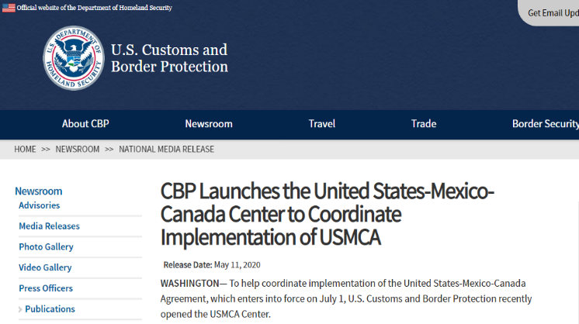
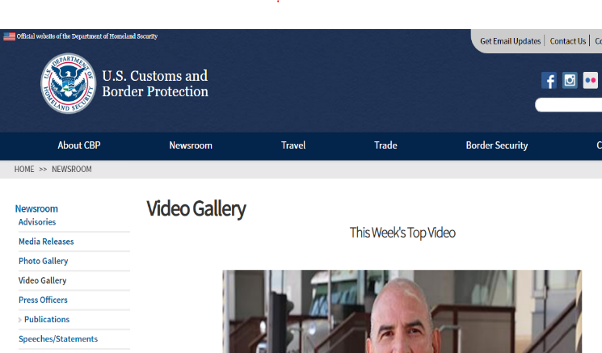
USMCA Resources
Press Releases / Media Engagement
Press releases and press engagements on USMCA Implementation arranged by CBP Office of Public Affairs (OPA)
Informational Videos
The USMCA Center is creating up to six videos to provide compliance guidance and resource navigation
Videos will be posted to CBP.gov and distributed widely to our trade stakeholders
USMCA Center

Slide 31
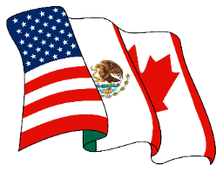
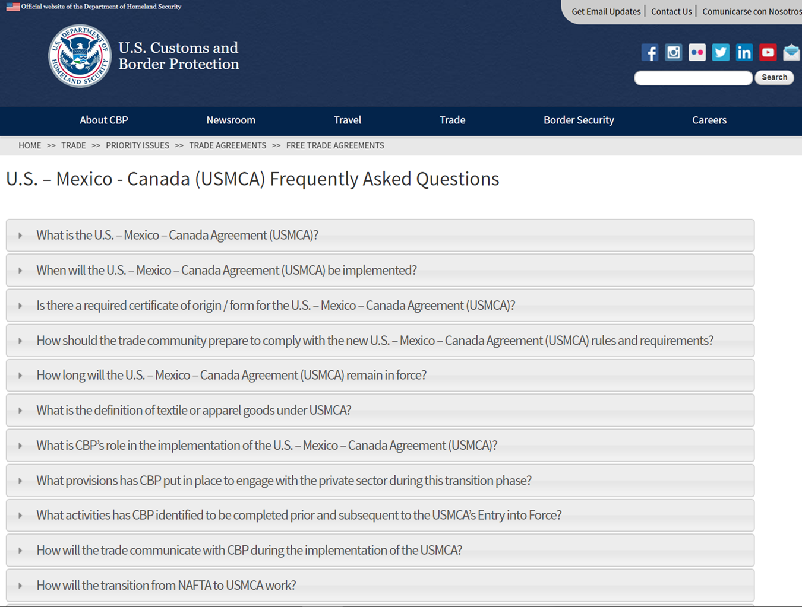
USMCA Resources
Factsheets
CBP OT is developing factsheets highlighting key provision updates and providing side-by-side comparison of the USMCA and NAFTA
Frequently Asked Questions (FAQs)
The USMCA Center maintains a FAQ page with questions received from the Trade
Recommended as the first and fastest resources to resolves inquiries
Information is continuously updated
USMCA Center

Slide 32
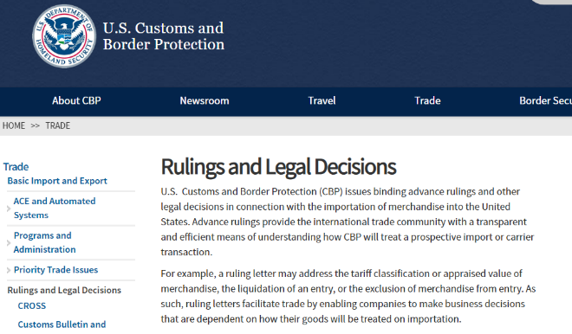
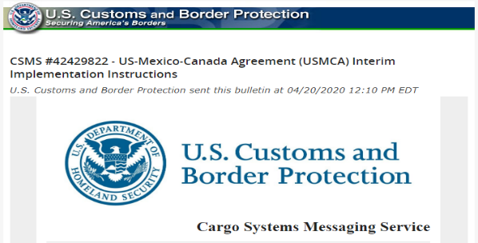
USMCA Resources
Binding Advance Rulings
Binding advance rulings and other legal decisions issued by CBP in connection with the importation of merchandise into the United States, including under special programs like trade agreements and special trade legislation (www.cbp.gov/trade/rulings).
Advance rulings provide the trade community with a transparent and efficient means of understanding how CBP will treat a prospective import or carrier transaction
Cargo System Messaging Service
CSMS is one of CBP’s methods for communicating to our trade partners relating to news and updates on the Automated Commercial Environment (ACE)
USMCA Center

Slide 33
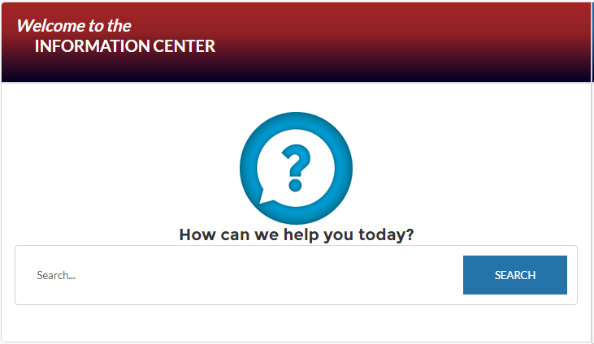
USMCA Resources
CBP Trade Snapshot Articles
Monthly Trade News Snapshot is an overview of the latest updates on trade enforcement and facilitation milestones – it highlights CBP’s important trade programs, initiatives, and operations for our trade partners and the public
CBP Information Center
AskCBP Search Engine – https://help.CBP.gov/
CBP Call Center – (877) 227-5511
Social Media
Facebook
Instagram (CBPGov)
Twitter (@CBPTradeGov)
YouTube
USMCA Center

Slide 34
USMCA Resources
Additional U.S. Government Resources
Harmonized Tariff Schedule of the United States (hts.usitc.gov)
U.S. Trade Representative (www.USTR.gov)
Federal Register Notices (www.federalregister.gov)
USTR published a Federal Register Notice on alternative staging regimes for automotive goods on April 21, 2020
The U.S. Department of Labor will be issuing a Federal Register Notice for the new and novel Labor Value Content requirement for automotive goods by June 30, 2020
U.S. Department of Commerce
For exporter information, refer to https://www.trade.gov/export-solutions
USMCA@cbp.dhs.gov
USMCA Center

Slide 35
Questions?
USMCA Center

Slide 36
Thank You!
USMCA Center

